Slide 1
Cyber @ UCI
Build Secure Software:
Intro to Application Security

Slide 2
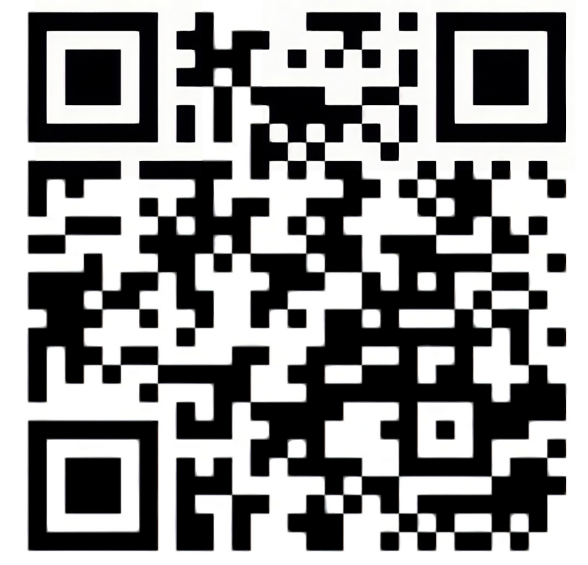
Attendance Form
“Intro to AppSec (WebJam)”

Slide 3
Today’s Agenda
Why (Application) Security?
  In Context of WebJam
Application Security Basics
Low-Hanging Fruits
  Exposed Secrets / Credentials
  SQL Injection
  Cross-Site Scripting
  Local File Inclusion
  Insecure Direct Object References
Mini CTF

Slide 4
General Disclaimer
You should only practice the techniques demonstrated today through official websites that have dedicated exercises and training for it (or explicitly grant you permission to do so), or on your own code and environment. :)
If you do any vulnerability scanning and testing on open-source applications, you should report it to the maintainers in a responsible manner. :)
If you decide to search more about hacking, please do so ethically. :)

Slide 5
What is Application Security (AppSec)?
Subfield of security that focuses on protecting software applications and systems against both unintentional failures and malicious threats
  Security-based processes in the software development lifecycle
  Code scanning automation to prevent “low-hanging fruit” from showing up in production
  Manual review of code and closed-box testing (e.g., penetration testing)
  Best practices to design secure applications and systems

Slide 6
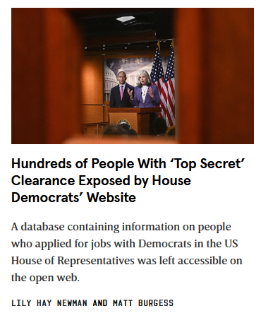
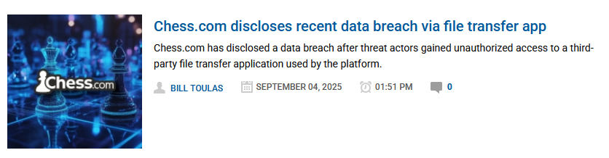
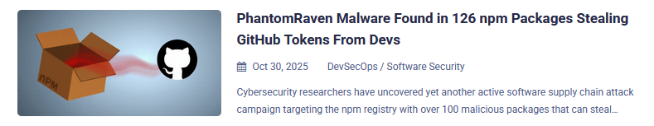
Why AppSec?

Slide 7
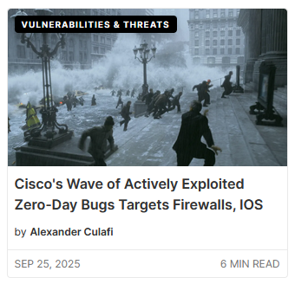
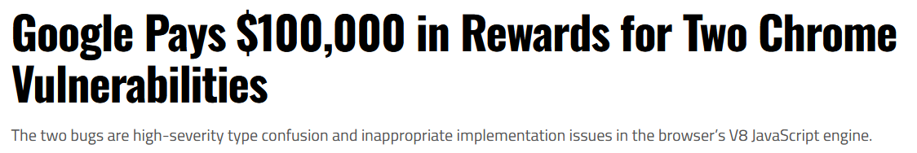
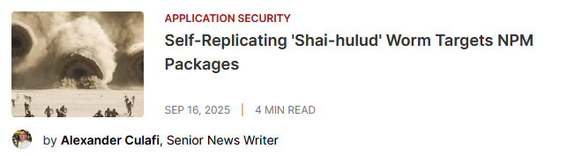
Why AppSec?

Slide 8
In Context of WebJam...
Reality: Security probably isn’t the focus of your web app…..
(unless you’re making some kind of security-themed web application)
But considerations for it may put your project over the top!
Panel of professor judges → Bringing up security considerations in your presentation just adds another point of ‘impression’
  Be cautious about your understanding in case they have follow-up questions
  Keep it simple – “I made sure SQL injection isn’t a problem by doing …”
If you decide to make your submission a cool side project, then it’s good experience to keep in mind security
  Resume builder and interview storytelling

Slide 9
AppSec-Related Tasks
Threat modeling – determining what security (and privacy) threats are viable and which ones should be prioritized
Auditing code for common vulnerabilities (or unique ones)
  Manual code reviews
  Code scanning with the help of tools
  Automated scanning integrated in the CI/CD pipeline
Developing tooling and systems to support automation, system defenses, and mitigations
Creating security processes for developers to follow and adhere to (and to support company compliance)
Supporting dev and product teams with secure design

Slide 10
Relevant Features
Authentication: Are users logging in with only their own set of valid credentials?
Authorization: Are the users who are supposed to see certain things the only ones who can actually see them?
Encryption: Can sensitive data (at-rest and in-transit) be accessed only by those who have the correct key?
Logging: If there were any suspicious activities or malicious threats, do you have any data to support further investigations?
Testing: Is your code actually secure against what you think it’s secure against?
Notes:
https://www.ibm.com/think/topics/application-security

Slide 11
Some Best Practices
Authentication: Implementing multi-factor auth, single sign-on; secure API auth standards (e.g., OAuth 2.0, JWT)
Authorization: Principle of least privilege, deny by default
Encryption: Don’t write your own encryption! Use approved algorithms (e.g., AES-256, RSA 2048, SHA-256)
Logging: Descriptive error messages, tracking third-party dependencies (e.g., Software Bill of Materials (SBOMs))
Testing: Automate your continuous testing (e.g., CI/CD), utilize static & dynamic analysis
Notes:
https://www.ibm.com/think/topics/application-security

Slide 12
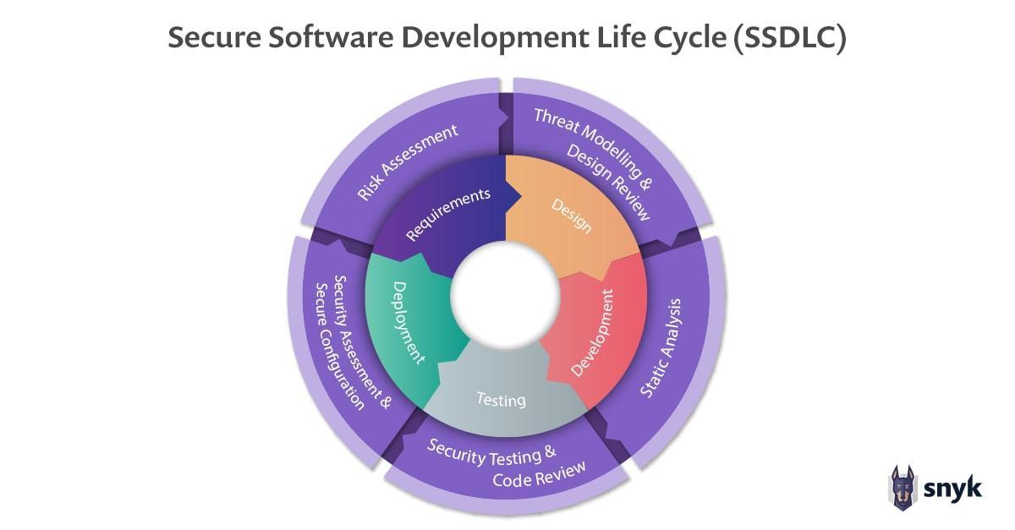
SDLC → Secure SDLC

Slide 13
OWASP Top 10
Top 10 list of “most critical security risks to web application”; last published in 2021
#1: Broken Access Control
#2: Cryptographic Failures
#3: Injection
#4: Insecure Design
#5: Security Misconfiguration
#6: Vulnerable and Outdated Components
#7: Identification and Authentication Failures
#8: Software and Data Integrity Failures
#9: Security Logging and Monitoring Failures
#10: Server-Side Request Forgery (SSRF)

Slide 14
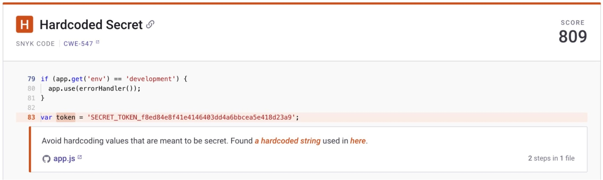
Exposed Secrets / Credentials
Especially if your code repo is public, you have to be careful about exposing your:
API keys
Passwords
SSH keys
Access tokens
Database connection strings
SaaS account IDs
Even then, secrets can be stolen by various means (i.e., other upcoming methods..)
Also be cautious about leaving secrets in comments!

Slide 15
SQL Injection
Overall Goal: Leveraging unsanitized SQL queries to your advantage
Target: Login to the user ‘stengo’ without knowing their password
Query:
“ SELECT * FROM users WHERE username = ‘{username}’ AND password = ‘{password}’ “
Thoughts on what you could do here?
Hints:
Add something in the username input that comments the rest of the check out…
OR add another component to the query that causes it to always be true…

Slide 16
SQL Injection
Query:
“ SELECT * FROM users WHERE username = ‘{username}’ AND password = ‘{password}’ “
Modified Query (with input):
“ SELECT * FROM users WHERE username = ‘stengo’--’ AND password = ‘{password}’ “
Effective Query Sent:
“ SELECT * FROM users WHERE username = ‘stengo’ ”

Slide 17
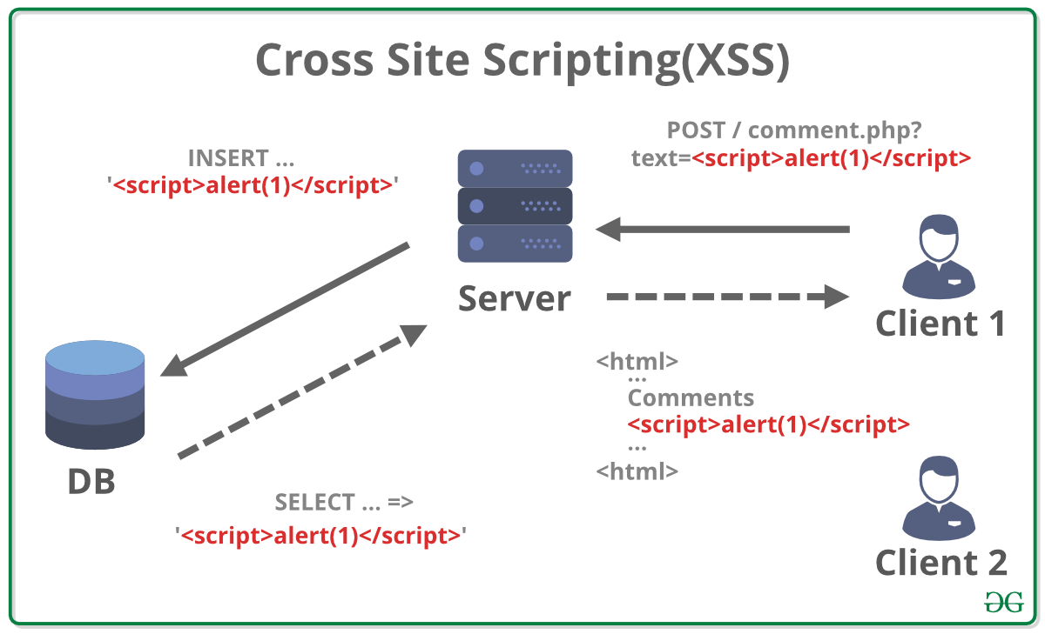
Cross-Site Scripting

Slide 18
Cross-Site Scripting
Three main kinds of XSS:
Reflected = From clicking on a malicious link that leads to the application to “reflect” the script in the site’s response, causing victim’s browser to execute it
Stored = Malicious script is stored on the server/application itself, so that whenever someone then renders that script (e.g., forum post, comment field), it is executed on the victim’s browser
Document Object Model (DOM)-based = Exploiting the DOM “environment” of the victim’s browser (e.g., web app’s JavaScript writes to the DOM w/o proper sanitization)

Slide 19
Cross-Site Scripting
Focusing on Stored XSS...
Before Payload
After Payload
<!doctype html><meta charset="utf-8"><title>Before</title>
<div id=out></div>
<p> Hi! This is my first forum post. </p>
...
<p> Hello! This is my second post. </p>
...
<p>[Where the next post would be rendered] </p>
<!doctype html><meta charset="utf-8"><title>Before</title>
<div id=out></div>
<p> Hi! This is my first forum post. </p>
...
<p> Hello! This is my second post. </p>
...
<p> <script> alert(“1”) </script> </p>

Slide 20
Local File Inclusion
Scenario: Imagine if your website directly accesses the local file system for a specific reason (e.g., to load images, render file text) → image repository
URL: https://catimages.com/?img=calico_cat1.png
(Fictional) code behind the scenes:
filename = request.args.get(‘img’, ‘’)
with open(filename, ‘r’) as f:
content = f.display()

Slide 21
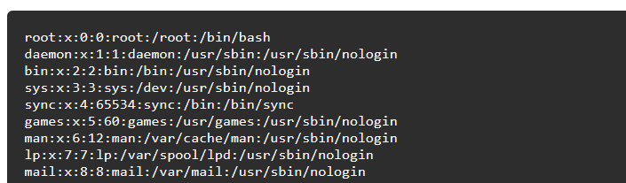
Local File Inclusion
Assume: The web server is hosted on a Linux server, so you can use the Linux file path formatting to your advantage…..
Modified URL: https://catimages.com/?img=../../../../../etc/passwd

Slide 22
Insecure Direct Object References (IDOR)
Picture this: After you login to your bank account, you get the following URL -
https://mellsmargo.com/account?user_id=2365832
What component of the URL would be different for each user of the bank’s website?
https://mellsmargo.com/account?user_id=1
https://mellsmargo.com/account?user_id=2365831
...

Slide 23
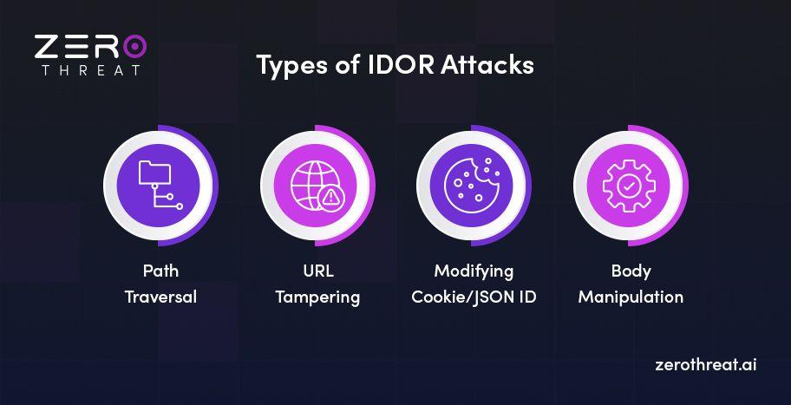
IDORs

Slide 24
AppSec CTF!
Go to ctfd.cyberuci.com, and create an account
Go to the “Challenges” tab
Go to vuln-site.cyberuci.com
Find the flags!

Slide 25
TL;DR...
A good chunk of these “low-hanging fruits” can be fixed by adding some sort of input sanitization or implementing additional authorization checks to resources
The challenges

Slide 26
Tools of Interest
Note: A lot of these tools are free for your own research and personal projects, but have an enterprise option when they are used by for-profit companies!
Semgrep: https://github.com/semgrep/semgrep
Aikido: https://github.com/AikidoSec
  Software Supply Chain: https://github.com/AikidoSec/safe-chain
  Software Composition Analysis: https://www.aikido.dev/scanners/open-source-dependency-scanning-sca
ZAP: https://www.zaproxy.org/
Trivy: https://trivy.dev/latest/
FuzzForge: https://github.com/FuzzingLabs/fuzzforge_ai
  “AI-Powered Workflow Automation” - experimental!

Slide 27
Additional Resources
Open Worldwide Application Security Project:
  https://owasp.org/Top10/
  https://owasp.org/www-project-api-security/
API Security.io:
  https://apisecurity.io/encyclopedia/content/owasp/owasp-api-security-top-10.htm
Snyk:
  https://snyk.io/learn/application-security/
  https://snyk.io/blog/10-react-security-best-practices/
NodeJS:
  https://nodejs.org/en/docs/guides/security/
OWASP Cheat Sheet Series:
  https://cheatsheetseries.owasp.org/cheatsheets/Forgot_Password_Cheat_Sheet.html
Gitlab:
  https://docs.gitlab.com/ee/user/application_security/dependency_scanning/

Slide 28
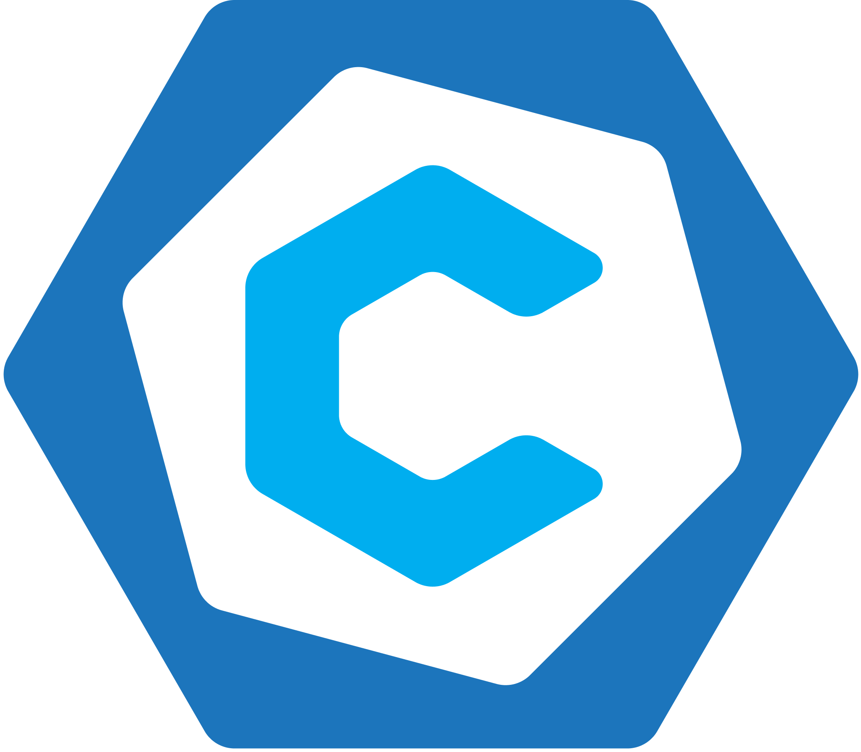
Join Cyber @ UCI
For more trainings on appsec and general security, come to our meetings!
Join our Discord: discord.cyberuci.com
Follow our Instagram: @ cyberuci
Our Fall ‘25 meetings are on Wednesdays from 6:30pm - 7:30pm
  Intro to Ethical Hacking next week!
  Guest speakers from Splunk/Cisco in 2 weeks!
Recruitment for various operation and competition teams throughout the year
  Join our Discord for the latest announcements!

